Slide 1
BUILDING RELIABLE SERVICES AT NRK TV
@EINARWH
Notes:
Hi everyone, thanks for coming to my talk. I’m going to talk about how we try to build reliable services at NRK TV.

Slide 2

Notes:
NRK TV is where I work. NRK is the public broadcaster i Norway, NRK TV is our TV streaming service.

Slide 3
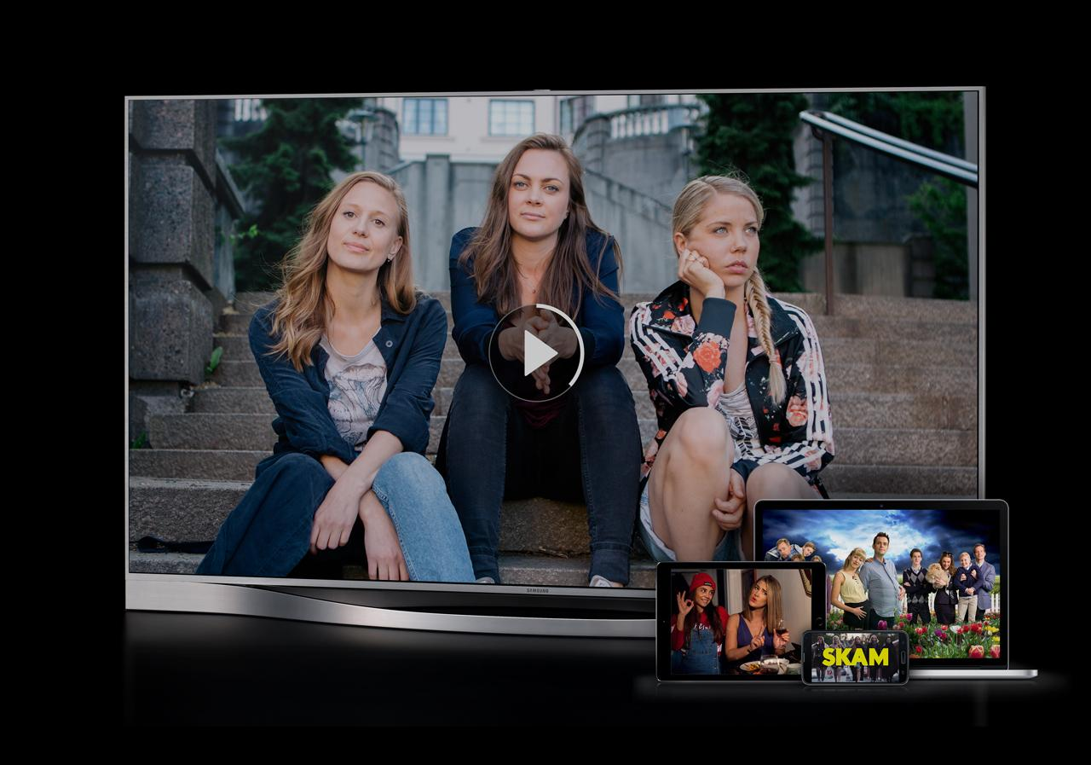
Notes:
So if you’re a Norwegian, you can use our service, NRK TV, to watch TV programming for a Norwegian audience, using your browser, your mobile phone or your smart TV. It is a serious software system in the sense that we have something like half a million users watching roughly half a million hours of content every day. And of course it varies quite a bit. And that variation is important.

Slide 4
AGENDA

Slide 5
WHAT IS THE SERVICE? WHAT IS RELIABILITY? RELIABILITY ENGINEERING STRESS TESTS TOOLS & TECHNIQUES
Notes:
So what I’m going to talk about today is this. First, we’ll look a little bit at the NRK TV service itself, because you can’t expect to build a reliable service if you don’t think about what the service is.
Then we’ll talk about what reliability means and how we can take that abstract notion and turn it into something concrete and actionable.
That’s going to lead us towards a process of reliability engineering. We want to be able to build reliability in a deliberate process.
And then we’ll see how we use stress tests as a part of that process, to verify that we reach our reliability goals.
And we’ll discuss some of the tools and techniques we use for that.

Slide 6
WHAT IS THE SERVICE? WHAT IS RELIABILITY? RELIABILITY ENGINEERING STRESS TESTS TOOLS & TECHNIQUES
Notes:
So what I’m going to talk about today is this. First, we’ll look a little bit at the NRK TV service itself, because you can’t expect to build a reliable service if you don’t think about what the service is.
Then we’ll talk about what reliability means and how we can take that abstract notion and turn it into something concrete and actionable.
That’s going to lead us towards a process of reliability engineering. We want to be able to build reliability in a deliberate process.
And then we’ll see how we use stress tests as a part of that process, to verify that we reach our reliability goals.
And we’ll discuss some of the tools and techniques we use for that.

Slide 7
WHAT IS THE SERVICE? WHAT IS RELIABILITY? RELIABILITY ENGINEERING STRESS TESTS TOOLS & TECHNIQUES
Notes:
So what I’m going to talk about today is this. First, we’ll look a little bit at the NRK TV service itself, because you can’t expect to build a reliable service if you don’t think about what the service is.
Then we’ll talk about what reliability means and how we can take that abstract notion and turn it into something concrete and actionable.
That’s going to lead us towards a process of reliability engineering. We want to be able to build reliability in a deliberate process.
And then we’ll see how we use stress tests as a part of that process, to verify that we reach our reliability goals.
And we’ll discuss some of the tools and techniques we use for that.

Slide 8
WHAT IS THE SERVICE? WHAT IS RELIABILITY? RELIABILITY ENGINEERING STRESS TESTS TOOLS & TECHNIQUES
Notes:
So what I’m going to talk about today is this. First, we’ll look a little bit at the NRK TV service itself, because you can’t expect to build a reliable service if you don’t think about what the service is.
Then we’ll talk about what reliability means and how we can take that abstract notion and turn it into something concrete and actionable.
That’s going to lead us towards a process of reliability engineering. We want to be able to build reliability in a deliberate process.
And then we’ll see how we use stress tests as a part of that process, to verify that we reach our reliability goals.
And we’ll discuss some of the tools and techniques we use for that.

Slide 9
WHAT IS THE SERVICE? WHAT IS RELIABILITY? RELIABILITY ENGINEERING STRESS TESTS TOOLS & TECHNIQUES
Notes:
So what I’m going to talk about today is this. First, we’ll look a little bit at the NRK TV service itself, because you can’t expect to build a reliable service if you don’t think about what the service is.
Then we’ll talk about what reliability means and how we can take that abstract notion and turn it into something concrete and actionable.
That’s going to lead us towards a process of reliability engineering. We want to be able to build reliability in a deliberate process.
And then we’ll see how we use stress tests as a part of that process, to verify that we reach our reliability goals.
And we’ll discuss some of the tools and techniques we use for that.

Slide 10
WHAT IS THE SERVICE? WHAT IS RELIABILITY? RELIABILITY ENGINEERING STRESS TESTS TOOLS & TECHNIQUES
Notes:
So what I’m going to talk about today is this. First, we’ll look a little bit at the NRK TV service itself, because you can’t expect to build a reliable service if you don’t think about what the service is.
Then we’ll talk about what reliability means and how we can take that abstract notion and turn it into something concrete and actionable.
That’s going to lead us towards a process of reliability engineering. We want to be able to build reliability in a deliberate process.
And then we’ll see how we use stress tests as a part of that process, to verify that we reach our reliability goals.
And we’ll discuss some of the tools and techniques we use for that.

Slide 11
WHAT IS THE SERVICE?
Notes:
So what is the service?

Slide 12
TV STREAMING SERVICE
Notes:
So obviously it’s a TV streaming service. I’m sure everyone in the audience is familiar with several TV streaming services, and for the Norwegians among you, presumably NRK TV itself.

Slide 13
TV STREAMING APP
Notes:
Most people will be familiar with a TV streaming service through some sort of app. It could a mobile app, or an AppleTV app, or a smart-TV app, or even the browser. That’s the public interface of the streaming service.

Slide 14
Notes:
We can just take a quick look at it.

Slide 15
CLIENT - SERVER
Notes:
Fundamentally of course it’s a client-server architecture. We have a bunch of different clients, native apps for mobile phones and tablets, smart-TV apps and a browser app. And we have a bunch of servers supporting those clients through an API.

Slide 16
PLAY THE GAME OF HUNT THE MEDIA MANIFEST
Notes:
In a sense, when you’re using a TV streaming app, you’re playing a game of hunt the media manifest. What the user really wants to do is watch their preferred TV show. To do that, they must navigate the app so they can get the appropriate manifest for that show.

Slide 17
CONTENT DELIVERY NETWORK FOR THE PETABYTES
Notes:
Once you have the media manifest, you stream the actual video content from a content delivery network. That’s not served from our servers at all.

Slide 18
OUR API IS A METADATA API
Notes:
So in a sense, our API is strictly a metadata API.

Slide 19
ALMOST EXCLUSIVELY READS
Notes:
It’s worth noting that the client-server interaction is almost exclusively read operations. Pretty much all HTTP GET. Which is great for us, since reads are much easier than writes.

Slide 20
WRITES FOR PROGRESS AND ANALYTICS
Notes:
We have a few writes, to report progress in watching a TV show, and for reporting analytics. The progress report is so that the user can pick up watching the same show where they left off.

Slide 21
TRAFFIC BURSTS
Notes:
Traffic can sometimes come in bursts, it’s not evenly distributed.

Slide 22
BIG LAUNCH = BLACK FRIDAY
Notes:
If we have a big launch for a hit show, or there is a big sports event, that can be a little bit like black Friday for us. But again, it helps that we do mostly reads. We can cache our way out of a lot of things.

Slide 23
WHAT IS A RELIABLE SERVICE?
Notes:
Ok, so this is fundamentally the service. How can we make it reliable?

Slide 24
WHAT DOES IT MEAN TO BE RELIABLE?
Notes:
First we need to decide what we mean by that. What does it mean for a service to be reliable?

Slide 25
ROBUST AND RESILIENT
Notes:
You will often hear people use words like robust and resilient, and that sounds nice, and probably has something to do with reliability. But that just postpones the problem in a way.

Slide 26
WHAT DOES IT MEAN TO BE ROBUST?
Notes:
We now have to consider, what does it mean to be robust?

Slide 27
WHAT DOES IT MEAN TO BE RESILIENT?
Notes:
And what does it mean to be resilient.

Slide 28
ROBUST
Notes:
Robustness is about how tough it is, how much stress you put it through, how much abuse it can take before going down.

Slide 29
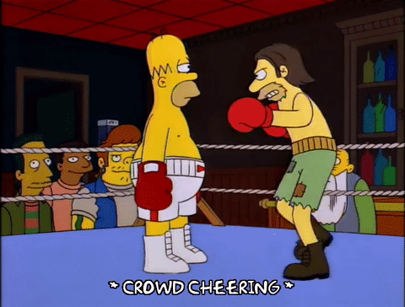
Notes:
There is a Simpsons episode where Homer starts boxing, and he does well, not because he is a good fighter, but because he is impossible to knock out. So he lets his opponents wear themselves out trying to knock him out, and when they’re exhausted, he can knock them out.
So Homer is not a good boxer, but he is a robust boxer.

Slide 30
RESILIENT
Notes:
Resilient is related, but not quite the same. Resilient is about bouncing back from failure, and continuing to work, to provide service, even under bad conditions.
So in terms of boxing, it’s more about getting back up when someone knocks you out, and then to keep moving forward. It’s more Rocky Balboa than Homer Simpson.

Slide 31
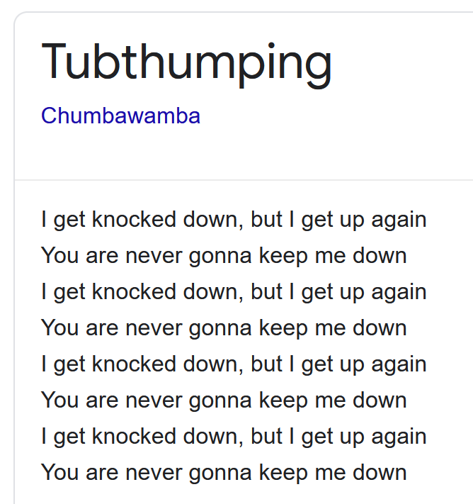
Notes:
There’s an annoying song from the 1990s that captures the spirit of resilience nicely.

Slide 32
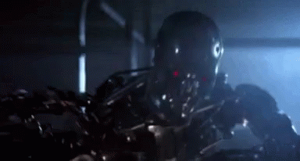
Notes:
But there’s also this property of not giving up, and to keep trying to accomplish your goal even in the presence of failure.

Slide 33
ROBUST AND RESILIENT ARE NOT BOOLEANS
Notes:
I want to stress that when we talk about robustness and resiliency, we’re not talking about booleans. It’s not true or false.

Slide 34
ROBUST AND RESILIENT ARE NOT EVEN PERCENTAGES
Notes:
They’re not even percentages.

Slide 35
ROBUST AGAINST CERTAIN KINDS AND AMOUNTS OF STRESS
Notes:
When we say that a service is robust, we mean that we’ve verified that it is robust against certain kinds and amounts of stress. That implies that we need to specify those kinds and those amounts.

Slide 36
RESILIENT UNDER CERTAIN KINDS OF BAD CONDITIONS
Notes:
Similarly, a system may be resilient against certain kinds of bad conditions. Again, it’s up to us to specify what those conditions are.

Slide 37
NON-FUNCTIONAL REQUIREMENTS
Notes:
Robustness and resiliency are non-functional requirements.

Slide 38
SPECIFIC AND CONTEXTUAL
Notes:
As such, they aren’t generic. They are specific and contextual.

Slide 39
DEPENDS ON THE SERVICE
Notes:
They apply to your service, and what they are are going to depend on what that service is.

Slide 40
BUSINESS REQUIREMENTS
Notes:
They’re business requirements, not technical considerations. Of course the business requirements lead to technical considerations and need to be backed by technical solutions, but they’re still business requirements.

Slide 41
«GOOD ENOUGH»
Notes:
But unfortunately, it can be hard to get a «business person» or a «domain expert» to articulate such requirements, apart from some very general notion of «good enough».

Slide 42
TYPICALLY NOT SPECIFIED
Notes:
So as a result, what counts as «good enough» is often not specified.

Slide 43
«BEST EFFORT»
Notes:
So we’re often left with best effort. Everyone tries their best to create something that works reasonably well most of the time. If there are obvious problems, we try to fix them.

Slide 44
BEST EFFORT IS A GIVEN
Notes:
But in a sense, that doesn’t give us much. Best effort is a given. Most developers try their best.

Slide 45
BEST EFFORT ISN’T AUTOMATICALLY GOOD ENOUGH
Notes:
But unfortunately, this «best effort» doesn’t automatically lead to something that is good enough.

Slide 46
SOMETIMES GOOD ENOUGH MUST BE REALLY QUITE GOOD
Notes:
Sometimes good enough has to be really quite good, and that doesn’t necessarily fall out of an ad hoc process driven by gut feelings.

Slide 47
WE MIGHT NOT REACH IT THROUGH BEST EFFORT ALONE
Notes:
It’s not a given that we’ll achieve that level of quality through best effort alone.

Slide 48
MINDSET
Notes:
I’d like to add a few words about developer mindset here. And the reason is that I’ve noticed a change in my own mindset since I started working more deliberately with reliability.

Slide 49
MOST DEVELOPERS ARE CONSCIENTOUS
Notes:
Most developers are conscientous people. They want to do the right thing.

Slide 50
COMPILE TIME MINDSET
Notes:
But at the same time, many developers primarily have a compile time mindset. We’re preoccupied with the business logic, which would be the functional requirements.

Slide 51
«THE CODE IS THE TRUTH»
Notes:
You may have heard thought leaders say things like «the code is the truth», and many developers believe in that.

Slide 52
WHAT TRUTH?
Notes:
But what truth is that?

Slide 53
THE TRUTH ABOUT WHAT?
Notes:
The truth about what?

Slide 54
WHAT HAPPENS IN PRODUCTION?
Notes:
I guess it must be about what’s going to happen in production, right? Because otherwise I don’t know what game we’re playing.

Slide 55
RUNTIME ENVIRONMENT
Notes:
But to know what’s going to happen at runtime, you also need to know the environment the code is going to execute in.

Slide 56
AVAILABLE RESOURCES
Notes:
You need to know something about what resources will be available.

Slide 57
EXTERNAL DEPENDENCIES
Notes:
You have to know about the external dependencies, which includes how those external dependencies behave.

Slide 58
THE RUNTIME IS DYNAMIC
Notes:
Fundamentally though, the runtime is a dynamic thing.

Slide 59
THE RUNTIME IS PARTIALLY OUT OF YOUR CONTROL
Notes:
And it’s also partially out of your control. Things can happen to the runtime that you’re not aware of. The execution of your code might be affected by other code running on the same node, or by all kinds of other things.

Slide 60
THE RUNTIME IS UNKNOWNABLE
Notes:
In a sense, there is always going to be something unknowable about the runtime.

Slide 61
RUNTIME BEHAVIOR IS NOT PURELY ANALYTICAL
Notes:
That means that you can’t really sit down at your desk and stare at the code and be exactly sure how it’s going to behave.

Slide 62
CODE + ENVIRONMENT
Notes:
Any truth that does not factor in this environment is going to be a lie.

Slide 63
RUNTIME MINDSET
Notes:
So we need to shift towards a runtime mindset, which factors in this unpredictability.

Slide 64
WE CAN’T FIGURE IT ALL OUT IN OUR HEADS
Notes:
We have to accept that we can’t figure it all out in our heads.

Slide 65
SYSTEMS THINKING
Notes:
And this leads us towards systems thinking.

Slide 66
HYPOTHESES AND VALIDATION
Notes:
Which means that we build our understanding of how our software works through hypotheses and validation in addition to the analytical approach.

Slide 67
BEING ON-CALL DOES WONDERS FOR THE RUNTIME MINDSET
Notes:
On a personal note, I’ll say that being on-call really does wonders for developing this runtime mindset. It’s not that I didn’t care before, but I care differently now. Skin in the game matters. I think differently. And I really value simplicity over sophistication.

Slide 68
HOW COMPLEX SYSTEMS FAIL RICHARD COOK
Notes:
I recommend reading this paper, How Complex Systems Fail, by Richard Cook, or watching one of his talks. Because we’re building complex systems.

Slide 69
RELIABILITY AT NRK TV
Notes:
Ok, so how do we work with reliability at NRK TV.

Slide 70
IMPROVEMENT START WITH A CRISIS
Notes:
I think improvements tend to start with a crisis.

Slide 71
OUR BEST EFFORT WASN’T GOOD ENOUGH
Notes:
And I think a couple of years ago now, we had not an immediate crisis, but a growing sensation that our best effort wasn’t good enough, it wasn’t producing the kind of reliability that we wanted.

Slide 72
HOW TO IMPROVE BEYOND BEST EFFORT?
Notes:
So we had to figure out a way to improve beyond best effort.

Slide 73
HOW CAN WE TELL IF IT IS GETTING BETTER OR WORSE?
Notes:
And we had at least to be able to figure out if things were getting better or worse, and how we could make sure that we were getting better faster than we were getting worse.

Slide 74
WE NEED FEEDBACK
Notes:
So for that, we need feedback.

Slide 75
ENGINEERING = BEST EFFORT + FEEDBACK
Notes:
I’m going to argue that best effort + feedback is sort of what engineering is all about.

Slide 76
FROM AD HOC TO STRATEGIC RELIABILITY WORK
Notes:
And the purpose was to go from ad hoc to strategic reliability work.

Slide 77
SERVICE LEVEL OBJECTIVE (SLO)
Notes:
And so we started looking at the field of Site Reliability Engineering, SRE. And we decided to define some SLOs for our services.

Slide 78
SERVICE LEVEL INDICATOR (SLI)
Notes:
And for that, you need to identify some service level indicators, something that you’re going to measure.

Slide 79
ERROR RATE
Notes:
Typical indicators include error rate.

Slide 80
LATENCY
Notes:
Latency or response time, which is something that you definitely care about when someone like an end user is waiting at the other end.

Slide 81
THROUGHPUT
Notes:
And also throughput, which is important for pipelines, like a publication pipeline for new content in a TV streaming service.

Slide 82
CAVEATS
Notes:
Ok, so the idea is to start measuring some things that matter to us, and use those to help back up our gut feeling with numbers. But I’d like to add some very important caveats to using metrics in this way.

Slide 83
METRICS CAN BE HARMFUL
Notes:
In general, any metric you choose can be harmful.

Slide 84
METRICS CAN BE ABUSED
Notes:
Any metric can be abused, typically by management.

Slide 85
METRICS CAN BE GAMED
Notes:
Any metric can be gamed, typically by developers.

Slide 86
UNDERMINES THE PURPOSE
Notes:
And all of these things are going to undermine the process of using these numbers to guide a healthy engineering process or structured improvement.

Slide 87
REQUIRES TRUST
Notes:
If you’re going to use metrics, you need trust in the organization, especially between people in different roles.

Slide 88
BOTTOM-UP
Notes:
When we started this process of defining SLO’s, it was a bottom-up process.

Slide 89
SELF-IMPOSED BY TEAM
Notes:
It was self-imposed by the team.

Slide 90
DEFINED BY TEAM
Notes:
It was defined by the team.

Slide 91
OWNED BY TEAM
Notes:
It was owned by the team.

Slide 92
NO REWARDS
Notes:
You definitely don’t want to associate rewards with reaching your SLO. That’s not the purpose of an SLO.

Slide 93
NO COMPETITION
Notes:
And you don’t want teams competing to reach the most ambitious SLO’s, because that means that you don’t understand that SLO’s should be tailored to the problem you’re addressing.

Slide 94
AN SLO should be Appropriate
Notes:
You want appropriate SLOs. If you can get away with a lax SLO, if a lax SLO is good enough, that’s much better than having to satisfy a strict SLO.

Slide 95
INVESTING IN MEETING A TOO-STRICT SLO IS WASTE

Slide 96
NO VANITY METRICS
Notes:
You don’t want your SLOs to turn into vanity metrics. It’s not something to wear on your chest.

Slide 97
WHAT ARE SLOS FOR?
Notes:
So those are the negatives. What are SLOs for then?

Slide 98
GUIDE DECISIONS
Notes:
The purpose of an SLO is to help guide decisions. Quite often, we must make technology choices, or even choices between different offerings from a cloud provider. For instance, you might have a choice between regular blob storage and premium blob storage. What should you choose? Well, you could choose the regular option first, and see if that’s enough to satisfy your SLO. If it’s not, you might try the premium offering. If that’s not enough, you need to go back to the drawing board and think of another solution.

Slide 99
TO HELP COMMUNICATE
Notes:
It’s also helpful to communicate to other teams and to management that you have to prioritize reliability work. It also helps communicate to the team itself what its priorities should be.

Slide 100
TO VALIDATE IMPROVEMENTS
Notes:
Of course you’ll use them to validate improvements. In fact, you can work out several design alternatives, run some experiments, and choose the one that fares best.

Slide 101
TO AVOID REGRESSIONS
Notes:
And you’ll have it in place to notice regressions when they happen. And they do happen. You might notice that you’re no longer consistently meeting your SLO, notice that the SLI has deteriorated over the last couple of weeks, and inspect what kinds of changes might have lead to that.

Slide 102
HOW TO DEFINE AN SLO
Notes:
With that in mind, understanding that the SLO is there to guide the team’s priorities and to highlight their challenges, not to assess the quality of the team’s work, how do you actually go about defining an SLO?

Slide 103
UNCOMFORTABLE!
Notes:
It’s actually quite uncomfortable, which is one reason I think developers tend to shie away from doing it.

Slide 104
UNCOMFORTABLE! (IT MUST BE GOOD!)
Notes:
But I think of it the other way around. If it’s uncomfortable, that means that we’re providing value. That’s the value add.

Slide 105
FORCE DECISIONS
Notes:
It’s valuable because it forces us to make decisions.

Slide 106
MAKE IT CONCRETE
Notes:
You can’t hand-wave about it, you have to be concrete.

Slide 107
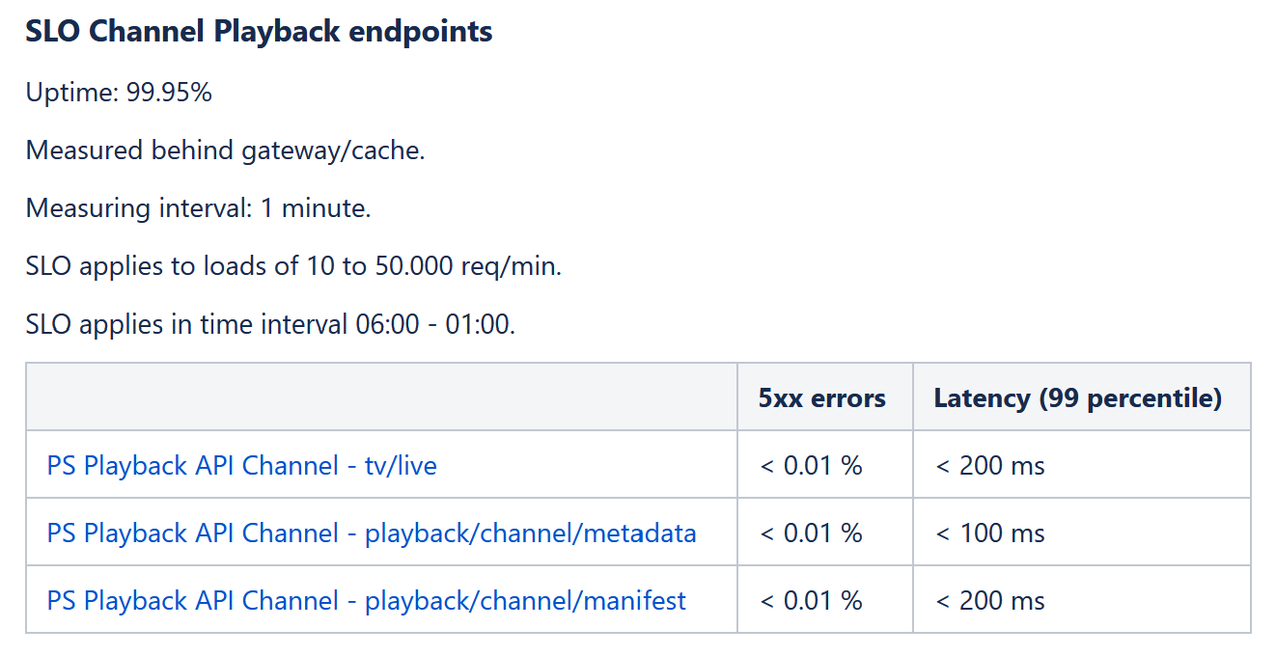
Notes:
So here’s an attempt to do just that for some of our endpoints, in one of our APIs. This is a pretty ambitious SLO.
What we measure here is the error rate and the response time for each endpoint. But you can see here that we had to make a number of choices.

Slide 108
START MEASURING CHOOSE OBJECTIVES OBSERVE REVISE/INVEST
Notes:
So here’s very simply our process, how we started using SLOs.

Slide 109
=> START MEASURING <= CHOOSE OBJECTIVES OBSERVE REVISE/INVEST
Notes:
We started by measuring the service level indicators. That’s already useful, because we got some numbers for things we cared about. To be honest, we already had those numbers, but we hadn’t thought of them as service level indicators.

Slide 110
START MEASURING => CHOOSE OBJECTIVES <= OBSERVE REVISE/INVEST
Notes:
Then we chose some objectives. And that was difficult. It felt very arbitrary. But you need to choose something that you can iterate on. You look at the numbers you have, scratch you chin, and choose something.

Slide 111
START MEASURING CHOOSE OBJECTIVES => OBSERVE <= REVISE/INVEST
Notes:
And then we started observing over time whether or not we met the objectives.

Slide 112
START MEASURING CHOOSE OBJECTIVES OBSERVE => REVISE/INVEST <=
Notes:
And then regularly we revise our SLOs or choose to invest in reliability measures.

Slide 113
START MEASURING CHOOSE OBJECTIVES => OBSERVE <= REVISE/INVEST
Notes:
And now you can iterate.

Slide 114
START MEASURING CHOOSE OBJECTIVES OBSERVE => REVISE/INVEST <=
Notes:
Revise or invest…

Slide 115
OBSERVATION
Notes:
Ok, so, observation, how do we do that?

Slide 116
DASHBOARDS

Slide 117
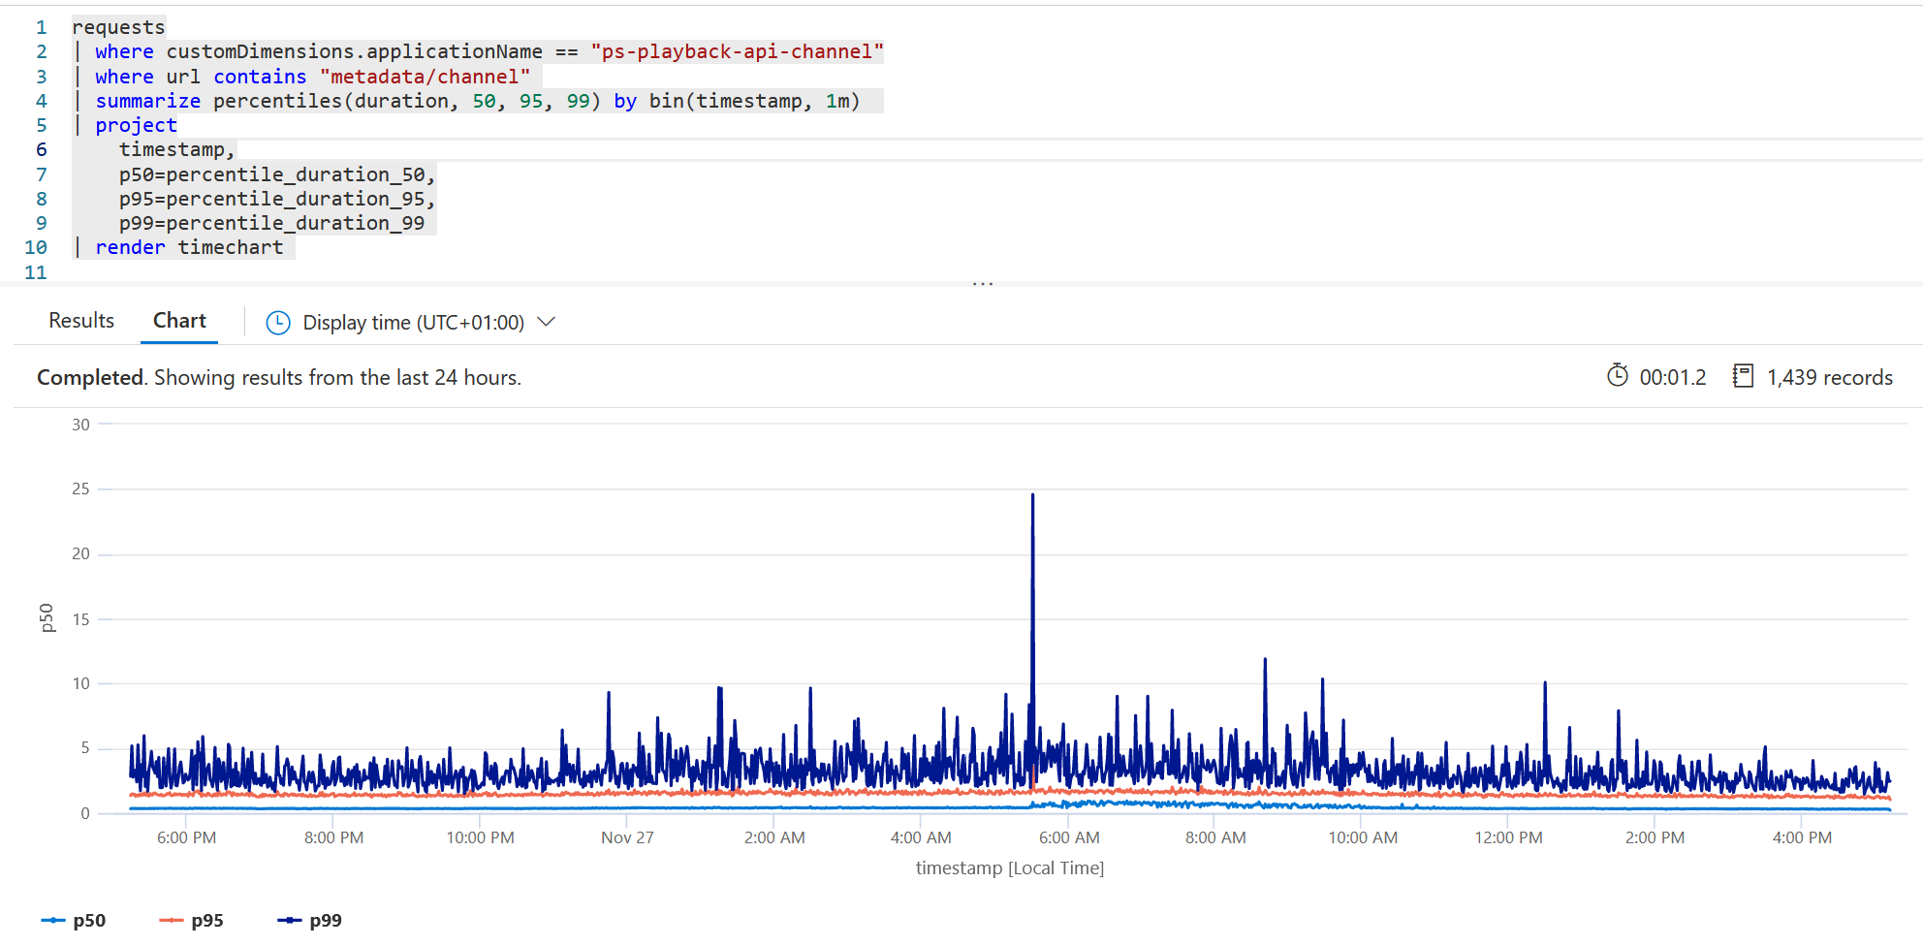
Notes:
This is application insights, with a query that gives us the 99th percentile for latency, along with the 95th percentile and the 50th percentile. Even though the SLO is defined for the 99th percentile, it’s interesting to see the other percentiles as well. That’s fine for a dashboard.

Slide 118
REPORTS
Notes:
And then we have reports, because we can’t stare at the dashboard all day every day

Slide 119
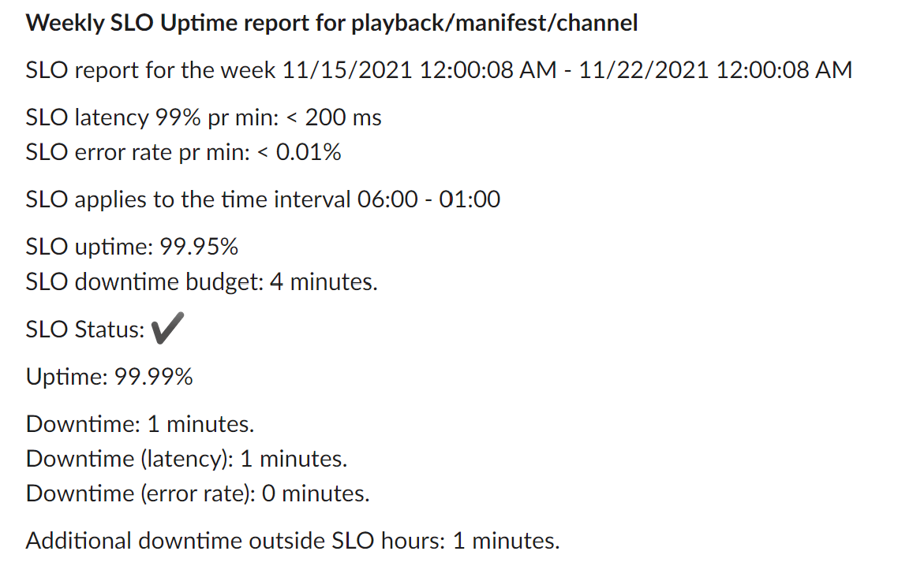
Notes:
One thing that several of our teams have implemented is a weekly uptime report that we post to a Slack channel. This makes it easy for us to see if we’re meeting our SLOs, and you get a trail. If we’re consistently meeting our SLOs for a given service, we might not need to do much reliability work on that service. That’s great, it means we can focus on functional requirements. But if we’re not, we’ll see it here.

Slide 120
NOTIFICATIONS?
Notes:
What about notifications? Initially, we were tempted to set up notifications as well.

Slide 121
SHOULD WE SET UP ALERTS FOR SLO VIOLATIONS?
Notes:
So we would set up alerts for on-going SLO violations. But that leads to a lot of noise, and it’s not clear what to do about it. Maybe you have an interval of 20 minutes where you don’t meet your SLO, but what should you do about it?

Slide 122
ALERTS SHOULD MEAN ACTION NECESSARY
Notes:
Alerts should mean that some kind of intervention or action is necessary, right?

Slide 123
IT’S NOT A HEALTH CHECK
Notes:
SLOs are not intended as health checks. We already have health checks for that, and we monitor those.

Slide 124
Notes:
So now we have our SLOs in place, and we have a process for monitoring and revising our SLOs, and for investing in reliability measures.

Slide 125
ARE WE RELIABLE NOW?
Notes:
Are we reliable now?

Slide 126
OF COURSE NOT!
Notes:
Of course not.

Slide 127
WE HAVE FEEDBACK
Notes:
What we have, is a feedback mechanism that we can use. I like to think of it as a compass, something that gives us direction.

Slide 128
WE CAN BEGIN WORKING
Notes:
Now we can begin this strategic improvement work.

Slide 129
ARCHITECTING FOR RELIABILITY
Notes:
I want to talk a little bit about architecting or designing for reliability as well.

Slide 130
RED AND GREEN SERVICES
Notes:
Roughly we distinguish between red and green services.

Slide 131
PLAYBACK
DESKING
SEARCH
NRK TV
RECOMMEND
ATIONS
PERSONAL IZATION
CATALOG
Notes:
At a high level, you can think of the TV streaming service somewhat like this, at least the public facing part of it.

Slide 132
PLAYBACK
DESKING
SEARCH
NRK TV
RECOMMEND
ATIONS
PERSONAL IZATION
CATALOG
Notes:
Nothing matters more than playback. There is no definition of uptime for us that doesn’t include «and you can play the content on your device».

Slide 133
PLAYBACK
DESKING
SEARCH
NRK TV
RECOMMEND
ATIONS
PERSONAL IZATION
CATALOG
Notes:
Whereas recommandations and personalization are nice to have, but ultimately not necessary to support the major use case.

Slide 134
PLAYBACK
DESKING
SEARCH
NRK TV
RECOMMEND
ATIONS
PERSONAL IZATION
CATALOG
Notes:
The editorial desking, the search and the ability to browse fall somewhere in the middle, because you do need to find the content as well.

Slide 135
SEPARATE SLOS
Notes:
We define separate SLOs for the different services, because they have different non-functional requirements. That’s what we indicate with the color codes.

Slide 136
SEPARATE RELIABILITY MEASURES
Notes:
That means we also want to employ separate reliability measures.

Slide 137
INDEPENDENT SERVICES
Notes:
We want these things to run as independent services.

Slide 138
FAILURE ISOLATION
Notes:
We also get failure isolation, which is both nice and important.

Slide 139
PARTIAL FAILURE
Notes:
It’s important because it creates the possibility for partial failure, which is a key enabler for resilience.

Slide 140
PARTIAL SUCCESS
Notes:
And we call it partial failure, but partial failure is also partial success.

Slide 141
GRACEFUL DEGRADATION
Notes:
If the service can keep running in a state of partial failure, it makes it possible for us to do graceful degradation instead of just going down completely.

Slide 142
VALIDATION
Notes:
But of course, that’s just theory at this point. The API is designed with that intent in mind, but that doesn’t help much if it doesn’t work in practice. The clients must also be able to cope with partial failure.

Slide 143
BROKEN PROXY
Notes:
One way to verify that graceful degradation works as intended is to insert what we call a broken proxy between the client and the server.

Slide 144
✗
MOBILE APP
API
✓ PERSONALIZATION ✓ PLAYBACK
✓ PERSONALIZATION ✓ PLAYBACK
Notes:
Say you have a mobile app that talks to the player API, and under normal circumstances, everything works as intended.

Slide 145
✗
MOBILE APP
BROKEN PROXY
API
✗ PERSONALIZATION ✓ PLAYBACK
✗ PERSONALIZATION
✓ PERSONALIZATION ✓ PLAYBACK
Notes:
Now what happens if we insert a broken proxy between the app and the API? The broken proxy enables us to take out individual services, add delays and so forth. The purpose of the test is to verify that the app doesn’t break, and that the user can still play video content. You want minimal disturbance from the outage.

Slide 146
THIS IS RESILIENCE
Notes:
This to me is resilience.

Slide 147
WHAT ABOUT ROBUSTNESS?
Notes:
Ok, but what about robustness?

Slide 148
MEETING SLO
Notes:
We talked about defining SLOs and meeting SLOs, but that doesn’t immediately tell us anything about robustness.

Slide 149
Notes:
In a sense, it’s no problem meeting your SLO on a sunny day. But not all days are sunny.

Slide 150
MEETING SLO ON A BAD DAY
Notes:
So for robustness, we want to look at meeting SLOs on a bad day.

Slide 151
MEETING SLO UNDER STRESS
Notes:
Which is to say, we want to see to what extent we can meet the SLO under stress.

Slide 152
EXPERIMENTS
Notes:
And for that, we run experiments, typically in our pre-production environment.

Slide 153
STRESS TESTS
Notes:
Those experiments take the form of stress tests.

Slide 154
TOOLS
Notes:
I’d like to mention some of the tools we use for this. I’m sure there are plenty of other tools out there, these are the ones we currently use. Basically we’ll use anything that helps us create useful experiments.

Slide 155

LOAD TESTING
Notes:
We use k6 for load testing. Our experience has been that k6 is easy to use. You write test scripts in JavaScript, configure a number of virtual uses to generate load.

Slide 156

RESILIENCE LIBRARY
Notes:
There’s a very nice library called Polly that supports various resiliency code patterns that you might want to employ. That’s things like timeouts, retries and circuit breaker that you might have heard about.

Slide 157

FAULT INJECTION LIBRARY
Notes:
There’s also Simmy, which is a fault injection library that integrates with Polly. You can compose faults with the resiliency patterns used to handle those faults. It’s pretty nice.

Slide 158

FEATURE TOGGLING
Notes:
And then we use Unleash, which is a feature toggling tool, to be able to turn faults on and off, and also to vary the intensity of the faults.

Slide 159
PURE LOAD TESTS
Notes:
We use pure load tests to find the breaking point for our services. At some point we find how much traffic we can handle. (Of course with the caveat that generated traffic is not necessarily identical to production traffic.)

Slide 160
VERIFY SCALABILITY
Notes:
Scale up the number of instances, re-run the experiment, and see if the breaking point is higher.

Slide 161
AUTOSCALE?
Notes:
You might wonder about autoscale, and we do use autoscale for some of our services. But first of all, your autoscale setup definitely requires validation. You need to verify that it works as you think it does. And when you have sudden bursts in traffic, like a big launch or a big sports event, autoscale might be too slow. So you might want to be able to scale up manually in front of those events.

Slide 162
LOAD TESTS WITH INTRODUCED FAULTS
Notes:
And then you have load tests with introduced faults.

Slide 163
SIMULATE FAILURE
Notes:
As before, with the broken proxy, the idea is to simulate some sort of failure.

Slide 164
WHAT CAN FAIL?
Notes:
Then you need to consider, ok, what is it that can fail?

Slide 165
FAILING DEPENDENCY
Notes:
Often, what fails is going to be a dependency of some sort.

Slide 166
HTTP CALL
Notes:
It might be an HTTP call.

Slide 167
DATABASE
Notes:
Or it might be the database connection, maybe the database is slow or down.

Slide 168
SECONDARY FAILURES
Notes:
And what’s interesting, is that these kinds of problems can lead to secondary failures, which might be more severe than the primary failures.

Slide 169
EXHAUST LIMITED RESOURCES
Notes:
In particular, both HTTP connections and database connections are limited resources. When you have latency or failure, each request might hold on to those for too long, and then there are no connections left for new requests.

Slide 170
HOW LONG DOES IT TAKE?
Notes:
So an interesting question is «how long does it take to fail»?

Slide 171
ASSUMPTION FAST FAILURE
Notes:
The assumption we often make is that failure is as quick as successs.

Slide 172
REALITY SLOW FAILURE
Notes:
But in reality, it’s often not like that. Many failures are slow. You’re waiting for a dependency that times out, and that’s when it fails.

Slide 173
STRATEGIES & REMEDIES

Slide 174
WHAT TO DO ABOUT FAILURE?

Slide 175
RELIABILITY PATTERNS

Slide 176
TIMEOUT
Notes:
Timeout places a cap on the time spent trying to fetch the resource.

Slide 177
RETRY
Notes:
If the dependency failed, we might choose to try to fetch it again. But that really means we’re betting that it’s a transient error. The realism of that is going to depend on the context you’re in.

Slide 178
CIRCUIT BREAKER
Notes:
And perhaps you’ve heard of circuit breaker as well, which basically means that you give up trying for a while to give the server a chance to get back up.

Slide 179
…
Notes:
And there are more, but we can’t cover them all.

Slide 180
SOME QUESTIONS

Slide 181
DO WE NEED THE RESULT?
Notes:
The first question to ask is «do we need the result»? Can we avoid making the call at all?

Slide 182
HOW BADLY DO WE NEED IT?
Notes:
Or perhaps better, «how badly do we need it»? Presumably we need it a little, perhaps we need it a lot. That’s going to matter for the strategy we choose.

Slide 183
DEFAULT VALUE?
Notes:
If we don’t need it that badly, perhaps we can make do with a short timeout and a default value.

Slide 184
CACHED VALUE?
Notes:
Or you might be able to use a cached value. That way, you will avoid making a bunch of calls that take up resources and could potentially fail.

Slide 185
CACHING
Notes:
In fact, I want to add a few more words about caching. I’m sure you do caching already, but still. It’s an important technique. So in a sense it’s just a controlled memory leak, but still, it can be so effective.

Slide 186
HTTP CACHE
Notes:
In particular, I want to mention the virtues of a simple HTTP cache. Basically it’s caching for free. You slap an HTTP cache, any HTTP cache, in front of your API, and you have a versatile tool that takes off a lot of load from your API, reducing the need for processing, protecting against failures, without complicating your API. Your API doesn’t need to know anything about, apart from making explicit to callers how long it’s OK to hang on to the result. That’s it. And that’s a useful question to ask anyway.

Slide 187
DESIGNING FOR CACHEABILITY
Notes:
In fact, it’s very useful to think about how we can design our systems for cacheability.

Slide 188
BÅRD’s TIME EXPANSION ALGORITHM
Notes:
I’d like to mention a specific example. At work, we have something called Bård’s «time expansion algorithm», named from a former co-worker who may or may not be in this room. Are you here Bård?

Slide 189
BÅRD’s TIME INDEPENDENCE PRINCIPLE
Notes:
The name is pretty bad, I think it’s perhaps more like a «time independence principle», because it’s not really an algorithm. It’s more an approach to design.

Slide 190
TIME-DEPENDENT TITLES
Notes:
For some of our TV shows, in particular the news shows, we have instalment titles that are dependent on time. I’m just going to show you real quick what I mean.

Slide 191
REFRESH TO SEE IF THE TITLE CHANGED?
Notes:
So how long should we cache this result? How often should the client make a new call to the API to see if something changed?

Slide 192
THIS IS STUPID
Notes:
So what Bård’s principle says is that this is stupid.

Slide 193
TITLES CHANGE VERY RARELY
Notes:
Titles as such change very rarely.

Slide 194
THIS IS COMPLETELY DETERMINISTIC
Notes:
This is completely deterministic. We know up front which titles should be presented at what times.

Slide 195
GENERATE A TABLE
Notes:
We can just generate a table with all the possible titles.

Slide 196
FROM | TO | TITLE
03.12.2021 00:00:00 | 04.12.2021 00:00:00 | I dag
04.12.2021 00:00:00 | 05.12.2021 00:00:00 | I går
05.12.2021 00:00:00 | 08.12.2021 00:00:00 | Fredag
 |  | 3. desember

Slide 197
TIME-DEPENDENT TITLES NO LONGER INFLUENCE CACHEABILITY

Slide 198
WHAT TO DO ABOUT FAILURE?
Notes:
Ok so back to this question, what to do about failure. We’ve seen that we can employ timeouts and retries, and that caching might help.

Slide 199
HYPOTHESIS
Notes:
In general a resiliency strategy is a hypothesis about what kinds of errors are going to occur, and what measures we can take to mitigate those errors.

Slide 200
VALIDATION
Notes:
And what we need to do is to validate that our hypothesis is correct.

Slide 201
CASE LINEAR CHANNEL PLAYBACK API
Notes:
I’d like to walk you through one such scenario, which is the resiliability work we have done on the linear channel playback API.

Slide 202
WHY IS THE LINEAR CHANNEL PLAYBACK API IMPORTANT?
Notes:
Why is this an important API? Well, it’s part of the playback API, so we know that it’s a red service. But more than that, as a public broadcaster, we have an obligation to provide information to the public in times of crises. The pandemic is an example of that, it’s important that the public be able to get information from the government about safety measures and so forth. You need to be able to go to NRK and watch the prime minister’s press conference, and the linear channel API is one way to support that scenario.

Slide 203
LOAD TESTS WITH INJECTED FAILURES

Slide 204
INJECTING FAILURE WITH SIMMY

Slide 206
CONTROLLING FAILURE CONFIG WITH UNLEASH

Slide 207
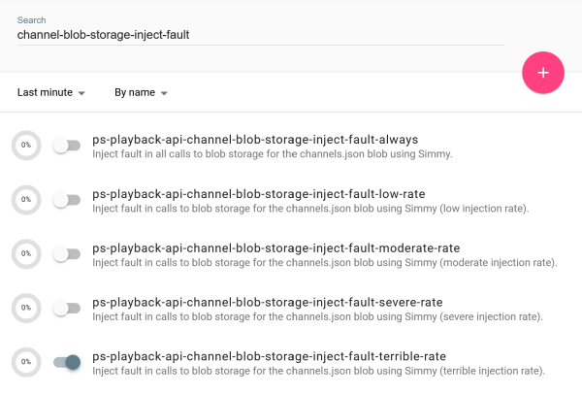

Slide 208
✗
CLIENT APP
API
BLOB
Notes:
At a very high level, the design looks something like this. The client app makes a request to the API, which reads the necessary information about metadata and streaming URL from a blob. This metadata can be updated out of band, but it happens rarely.

Slide 209
✗
ORIGINAL DESIGN
API
CLIENT APP
BLOB
CACHE
Notes:
This is roughly the original design. We have a client app, it makes a request to the API. The endpoint needs data from the blob, so it fetches it from the blob, and then it caches it. Since the blob changes very infrequently, we can cache the blob for quite a while. So maybe we cache it for 5 minutes. We could probably cache it for an hour, but in the grand scheme of things, the difference between those numbers doesn’t really matter.

Slide 210
EXPERIMENT

Slide 211
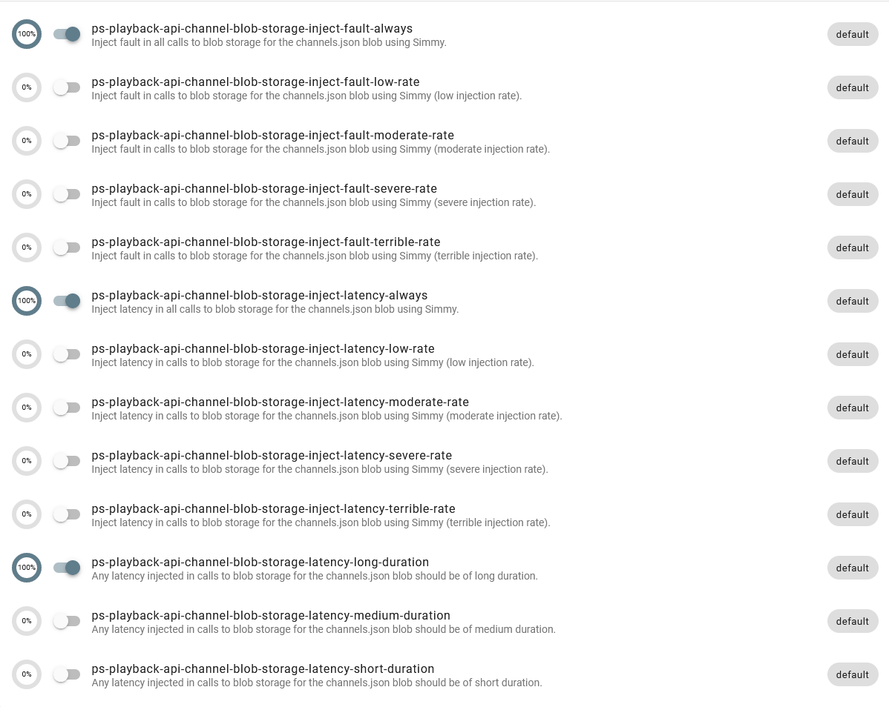

Slide 212
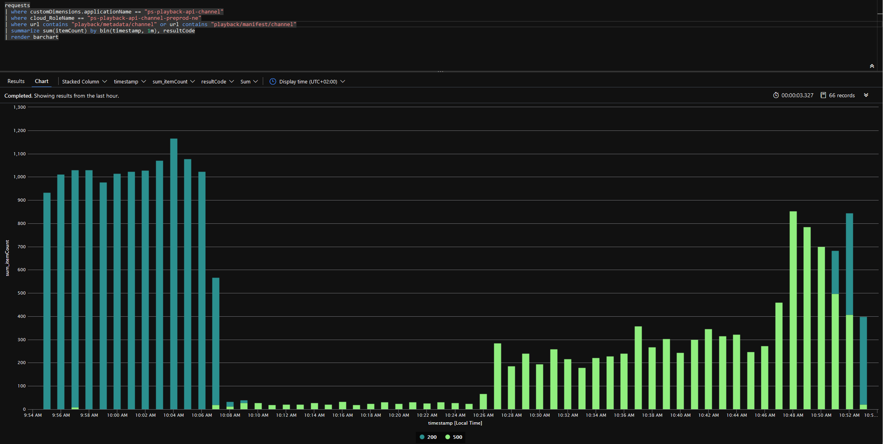
Calls take 60 seconds but 10% succeed.
Chaos monkeys let loose. All dependencies take 60 seconds and then fail.
Even more load…
Things are even worse, more errors under increased load.
Increase load from k6.
Everything is horrible!

Slide 213
BUT STILL…
Notes:
But it’s still not great. So how can we improve the design?

Slide 214
✗
REVISED DESIGN
API
CLIENT APP
DATA
READ
BLOB
UPDATE
HOSTED SERVICE
HTTP
Notes:
Here’s the revised design.

Slide 215
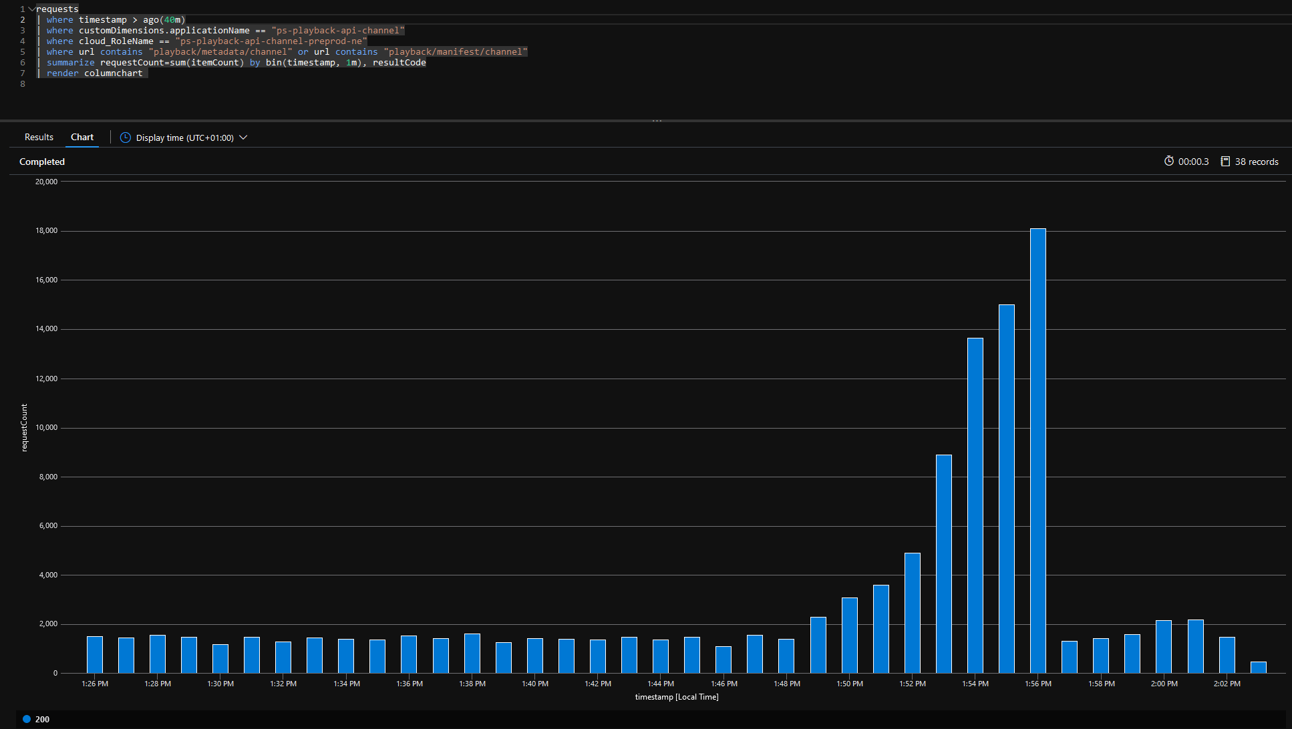
Chaos monkeys let loose. All dependencies take 60 seconds and then fail.
Gradually increasing load from k6
Chaos monkeys give up.

Slide 216
INJECTED FAULTS MADE IRRELEVANT
Notes:
This design makes the injected faults irrelevant in a way. I didn’t include The only consequence of the injected faults is that any changes to the metadata blob will be invisible, they will not be applied.

Slide 217
IS IT ROBUST?
Notes:
Is this a robust design?

Slide 218
TRICK QUESTION!

Slide 219
ROBUST ISN’T A BOOLEAN!

Slide 220
VERY ROBUST AGAINST BLOB DOWNLOAD PROBLEMS

Slide 221
NOT ROBUST AGAINST AZURE GOING DOWN

Slide 222
THE CASE STUDY IS A SIMPLE SCENARIO

Slide 223
MANY OTHER SCENARIOS ARE MUCH HARDER

Slide 224
TRADE-OFFS CAN BE MORE PAINFUL

Slide 225
ONLY AS GOOD AS THE EXPERIMENTS

Slide 226
«I HAVEN’T BEEN ABLE TO MAKE IT FAIL»

Slide 227
SUMMARY

Slide 228
RELIABILITY ENGINEERING REQUIRES FEEDBACK

Slide 229
THE RIGHT MECHANISMS ARE CONTEXT-DEPENDENT

Slide 230
EXPLOIT CONTEXT TO FIND GOOD SOLUTIONS

Slide 231
ALWAYS VALIDATE

Slide 232
RUN EXPERIMENTS

Slide 233
LISTEN TO THE FEEDBACK

Slide 234
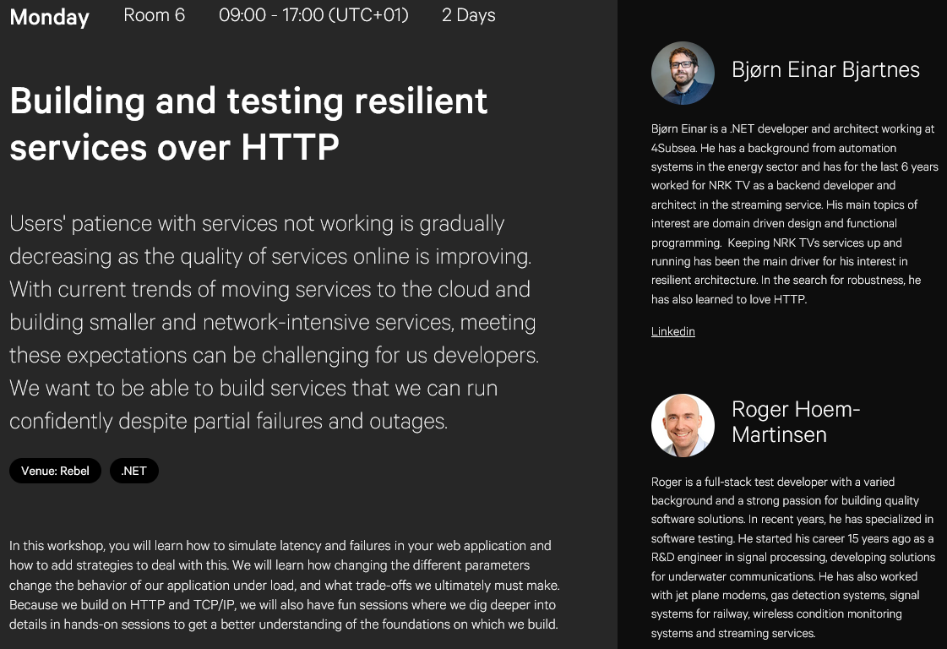

Slide 235
https://github.com/bjartnes/bounded-disturbances

